Slide 1
Logging Managing For Openstack
Logstash+Elasticsearch+Kibana+Elastic-recheck

Slide 2
Agenda
History
ELK Stack
Elastic-recheck

Slide 3
History: Logging State for Openstack
There is no real unified or agreed upon standard for how to do logging, across software platforms, so it is typically left up to the software designer to choose how to design and output logs.
Logs can produce an overwhelming amount of information. Many of the traditional tools do nothing to correlate and represent the data that they collect. Therefore, narrowing down specific issues can also become very difficult.
How to detect a failures unrelated to the patches being tested? How to check your bug’s state(new？reported? gone away?)?How to notify developer a known bug?

Slide 4
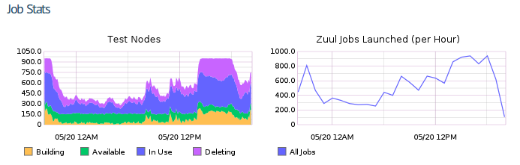
History: Job Stats for Openstack

Slide 5
History: Logging Manging for Openstack
In 2013, Clark began implementing an Elasticsearch + Logstash + Kibana (the ELK stack) solution for the OpenStack infrastructure.
Over that summer, Sean created some sample code to talk to the web service. Joe Gordon and Matthew Treinish then turned the sample code into elastic-recheck in September of 2013, when stress on the project infrastructure hit a high point and manual rechecks were common.
Elastic-recheck: use ElasticSearch to classify OpenStack gate failures
A more automated solution, using Elasticsearch to address many of the issues with the manual process so that developers could be automatically notified if their change hit a known bug.

Slide 6
Agenda
History
ELK Stack
ELK Stack introduction
Logstash, ElasticSearch & Kibana
ELK Stack for openstack
Competitive analysis
Elastic-recheck

Slide 7
ELK Stack：Components
ElasticSearch is a schema-less database that has powerful search capabilities and is easy to scale horizontally. Schema-less means that you just throw JSON at it and it updates the schema as you go. It indexes every single field, so you can search anything (with full-text search) and it will aggregate and group the data.
logstash allows you to pipeline data to and from anywhere. This is called an ETL (for Extract, Transform, Load) pipeline in the Business Intelligence and Data warehousing world, and it is what allows us to fetch, transform, and store events into ElasticSearch.
Kibana is a web-based data analysis and dashboarding tool for ElasticSearch. It leverages ElasticSearch’s search capabilities to visualise your (big) data in seconds.

Slide 8
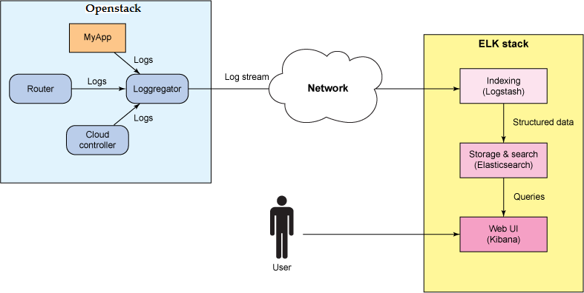
ELK Stack: Work Flow

Slide 9
Agenda
History
ELK Stack
ELK Stack introduction
Logstash, ElasticSearch & Kibana
ELK Stack for openstack
Competitive analysis
Elastic-recheck

Slide 10
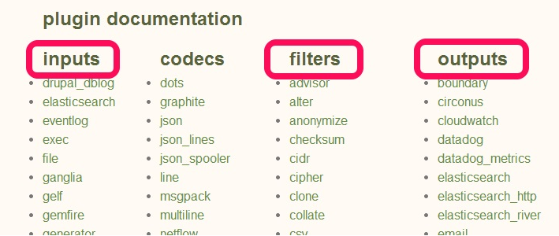
Logstash: ETL pipeline made simple
logstash is a simple tool that streams data from one or many inputs, transforms it and outputs it to one or many outputs.
Inputs: read and parse data
Filters: transform and extend data
Output: load data

Slide 11
Logstash: simple example
$ cat logstash-simple.conf
input { stdin { } }
output {
elasticsearch { host => localhost }
stdout { codec => rubydebug }
}
$ bin/logstash -f logstash-simple.conf
hihihihi
{
"message" => "hihihihi",
"@version" => "1",
"@timestamp" => "2015-04-03T08:45:32.749Z",
"host" => "dai"
}

Slide 12
Elasticsearch: Search & Analyze Data in Real Time
ElasticSearch is an Open Source (Apache 2), Distributed Search Engine built on top of Apache Lucene.
A few sample ES use-cases:
an online web store
collect log or transaction data to analyze and mine this data to look for trends, statistics, summarizations, or anomalies
a price alerting platform
analytics/business-intelligence needs and want to quickly investigate, analyze, visualize, and ask ad-hoc questions on a lot of data (think millions or billions of records)

Slide 13
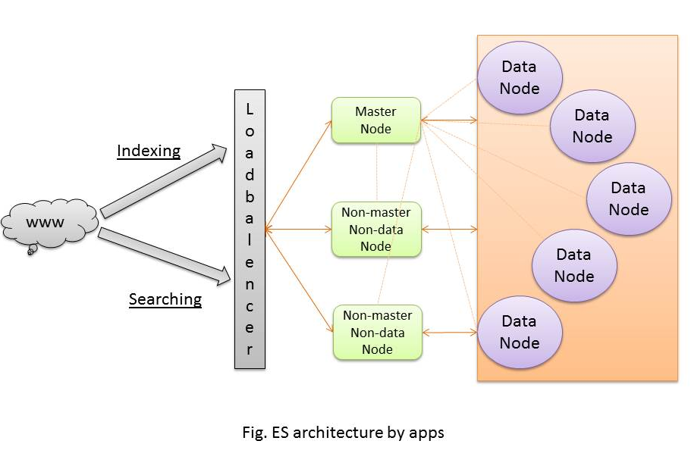
Elasticsearch Architecture

Slide 14
Elasticsearch: some RESTFUL API
# list all nodes and all indices
>> curl 'localhost:9200/_cat/nodes?v'
>> curl 'localhost:9200/_cat/indices?v‘
# create an index named "customer“
>> curl -XPUT 'localhost:9200/customer?pretty‘
# delete the index that we just created
>> curl -XDELETE 'localhost:9200/customer?pretty'
Notes:
http://www.elastic.co/guide/en/elasticsearch/reference/master/index.html

Slide 15
Kibana
An open source analytics and visualization platform designed to work with Elasticsearch.
Used to search, view, and interact with data stored in Elasticsearch indices.
Make it easy to understand large volumes of data.
Its simple, browser-based interface enables you to quickly create and share dynamic dashboards that display changes to Elasticsearch queries in real time.

Slide 16
Agenda
History
ELK Stack
ELK Stack introduction
Logstash, ElasticSearch & Kibana
ELK Stack for openstack
Competitive analysis
Elastic-recheck

Slide 17
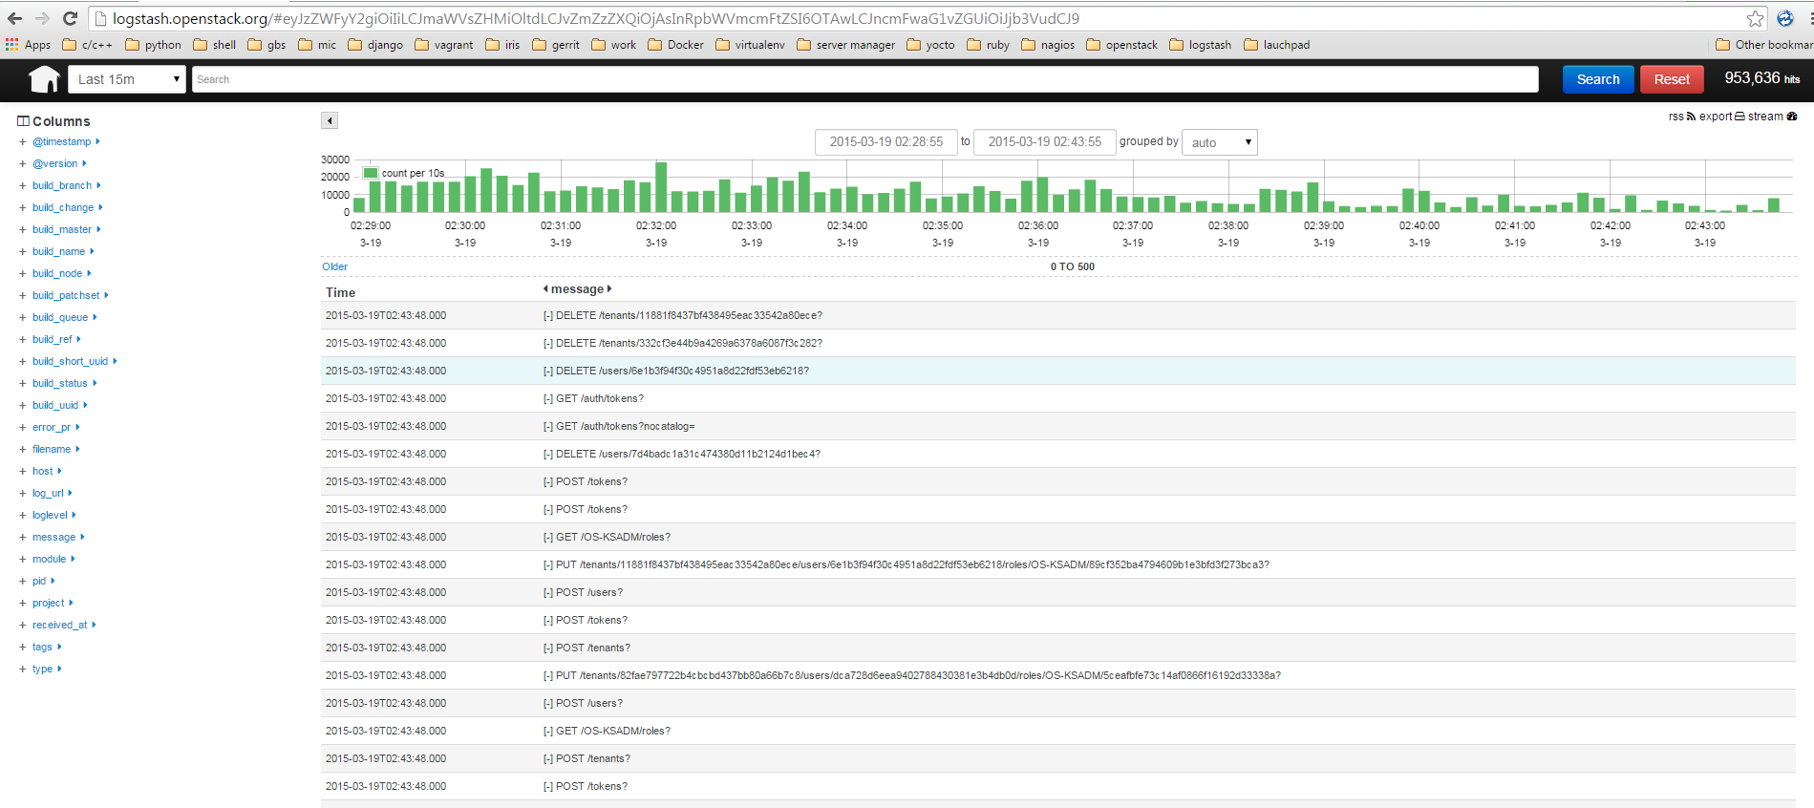
ELK Stack (Elasticsearch+Logstash+Kibana)

Slide 18
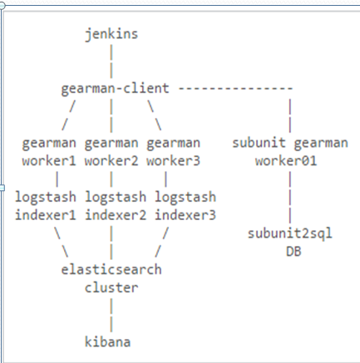
ELK Setup For Openstack
Four major layers:
Log Pusher Scripts
Logstash Indexer
ElasticSearch
Kibana

Slide 19
Agenda
History
ELK Stack
ELK Stack introduction
Logstash, ElasticSearch & Kibana
ELK Stack for openstack
Competitive analysis
Elastic-recheck

Slide 20
ELK Stack vs Splunk
Splunk ≈ ELK Stack
ELK Stack =
Logstash(ingestion and processing)
ElasticSearch(search)
Kibana(reporting and visualization)
ElasticSearch =
Lucene
Search
Splunk :
Commercial software
Charge
ELK Stack:
An Apache-licensed open source endeavor
A lower barrier

Slide 21
Scribe vs Chukwa vs Kafka vs Flume
Facebook's Scribe
a scalable, fault-tolerant solution
Apache’s Chukwa
belonging to the the hadoop series products
supporting the the hadoop cluster log analysis
LinkedIn’s Kafka
using the Scala language
using a variety of efficient optimization mechanism
more suitable for heterogeneous clusters
Cloudera's Flume
complete components

Slide 22
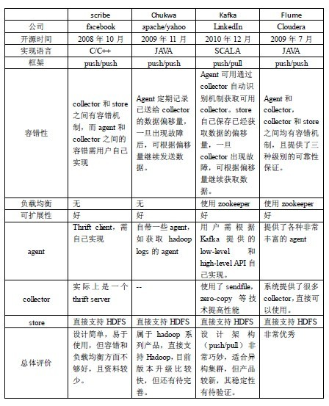
Scribe vs Chukwa vs Kafka vs Flume

Slide 23
Agenda
History
ELK Stack
Elastic-recheck
Elastic-recheck introduction
Example: Creating bug 1349617 in Elastic-rechek
Example: Automatic responses for a Gerrit patch

Slide 24
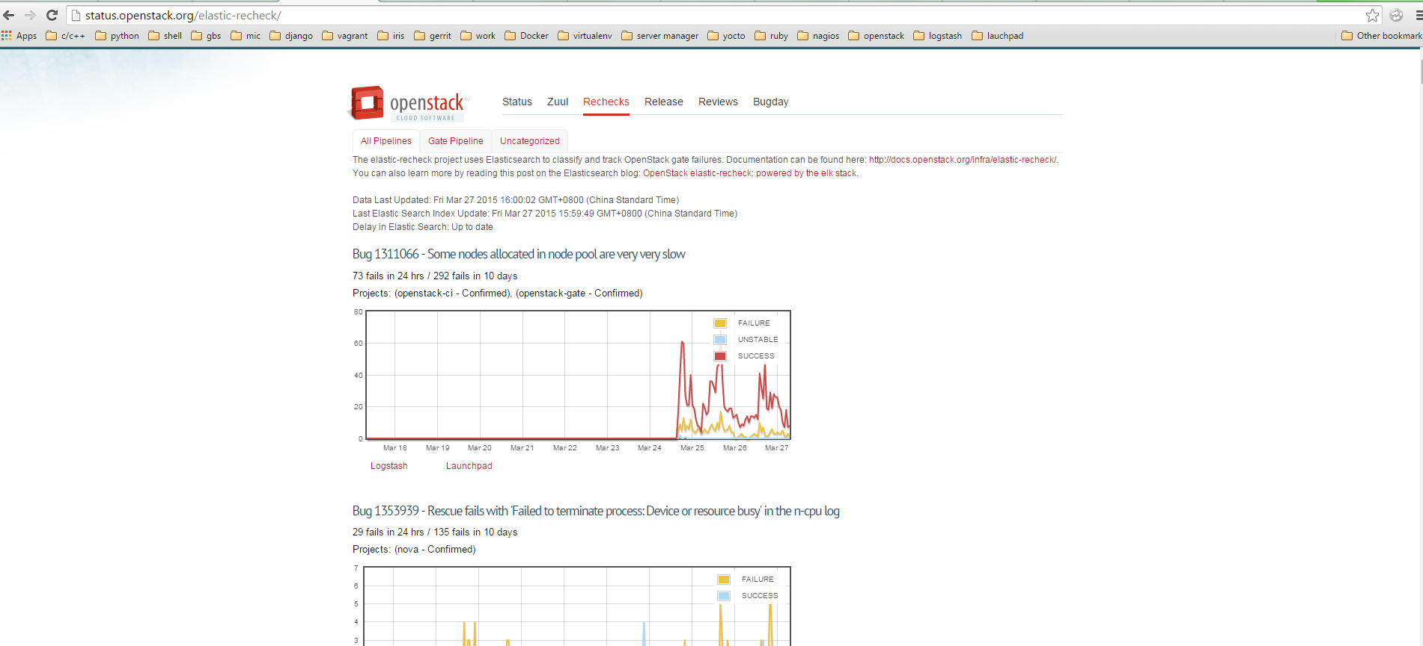
Elastic-recheck
Notes:
http://status.openstack.org/elastic-recheck/

Slide 25
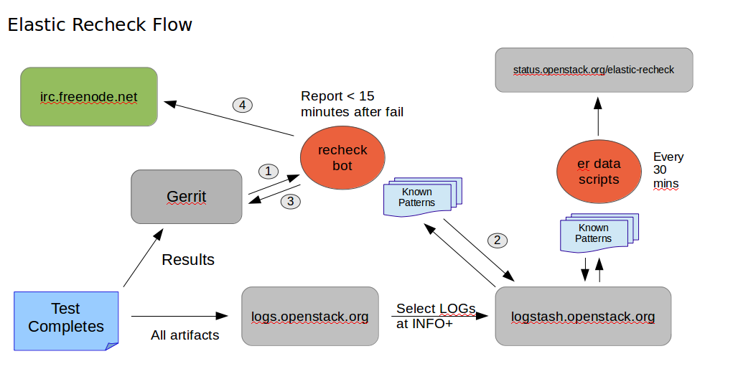
Elastic-recheck Flow

Slide 26
Agenda
History
ELK Stack
Elastic-recheck
Elastic-recheck introduction
Examples

Slide 27
Examples: Creating Bug 1349617 in Elastic-recheck
Find a log that is associated with the failure.
“SSHException: Error reading SSH protocol banner[Errno 104] Connection reset by peer .”
Go to logstash.openstack.org and create an elastic search query to find the log message from step 1.
message:"Failed to establish authenticated ssh connection to cirros@" AND message:"(Error reading SSH protocol banner[Errno 104] Connection reset by peer). Number attempts: 18. Retry after 19 seconds." AND tags:"console"

Slide 28
Examples: Creating Bug 1349617 in Elastic-recheck
Create a bug in our bug tracker for the error, add a comment to the bug with the exact query identified via Kibana, and a link to the logstash url for that query search.
https://bugs.launchpad.net/neutron/+bug/1349617
Submit a simple YAML-based change to the elastic-recheck repository's queries/ directory, which contains the list of bugs to track.
https://git.openstack.org/cgit/openstack-infra/elastic-recheck/tree/queries.

Slide 29
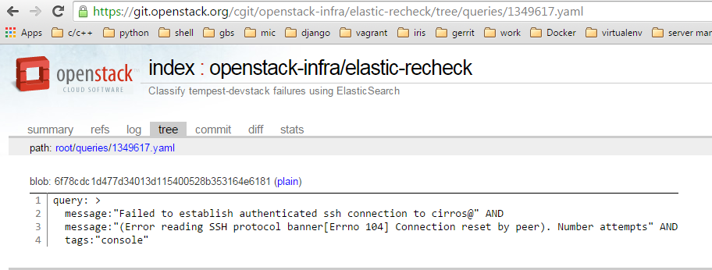
Examples: Creating Bug 1349617 in Elastic-recheck

Slide 30
Examples: Creating Bug 1349617 in Elastic-recheck
A bug in elastic-recheck will be created after patch is merged.
http://status.openstack.org/elastic-recheck/#1349617
An aggregation of all failed gate jobs that don’t currently have elastic-recheck fingerprints:
http://status.openstack.org/elastic-recheck/data/uncategorized.html

Slide 31
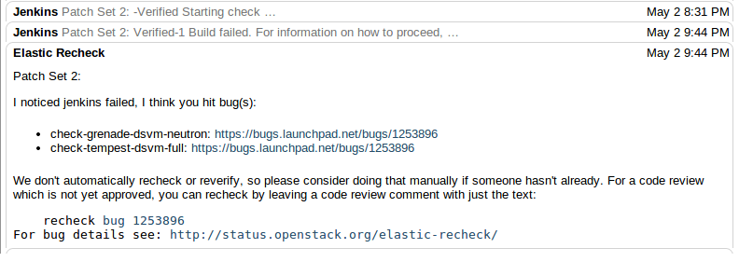
Examples: Automatic Responses for A Gerrit Patch

Slide 32
References
ELK Stack:
https://www.elastic.co/
http://brewhouse.io/blog/2014/11/04/big-data-with-elk-stack.html
Elastic-recheck Documentation:
http://docs.openstack.org/infra/elastic-recheck/
https://www.elastic.co/blog/openstack-elastic-recheck-powered-elk-stack/

Slide 33


